Slide 1
The Cool Code Consortium
8-2-2017
Notes:
Use this for Pro Audio Segments

Slide 2
Stuff
Cool Things
Cool News
Cryptography
Next Week

Slide 3
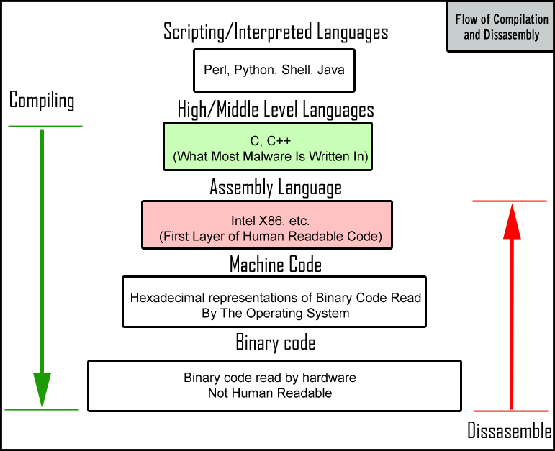

Slide 4
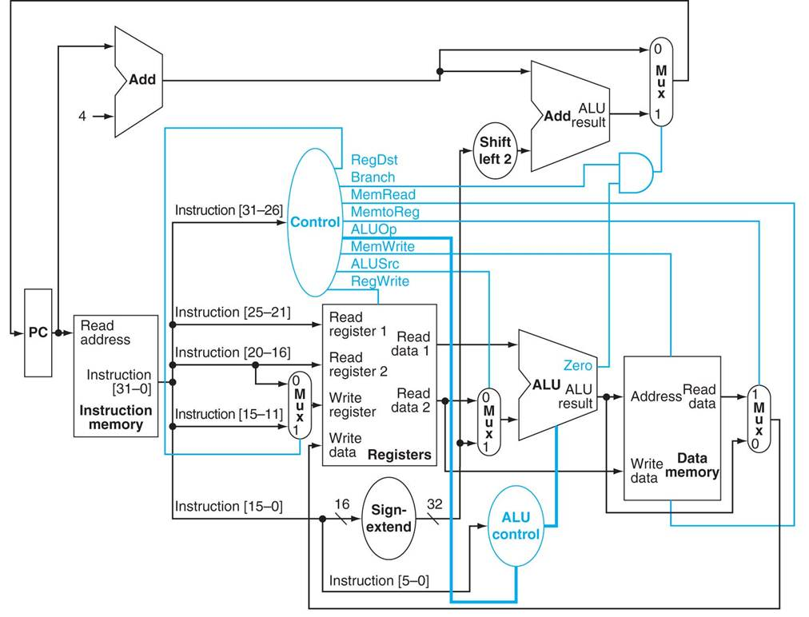

Slide 5
Cool Things
Facebook Group
Picture

Slide 6
Cool News
http://www.independent.co.uk/life-style/gadgets-and-tech/news/google-my-activity-search-history-internet-browsing-how-to-see-hide-delete-privacy-a7868401.html
http://www.dailymail.co.uk/sciencetech/article-4747914/Facebook-shuts-chatbots-make-language.html?ito=social-facebook_Australia
http://www.disclose.tv/news/giant_batlike_creature_reported_by_three_separate_witnesses_in_chicago_april_2017/138764

Slide 7
Cryptography

